Slide 1
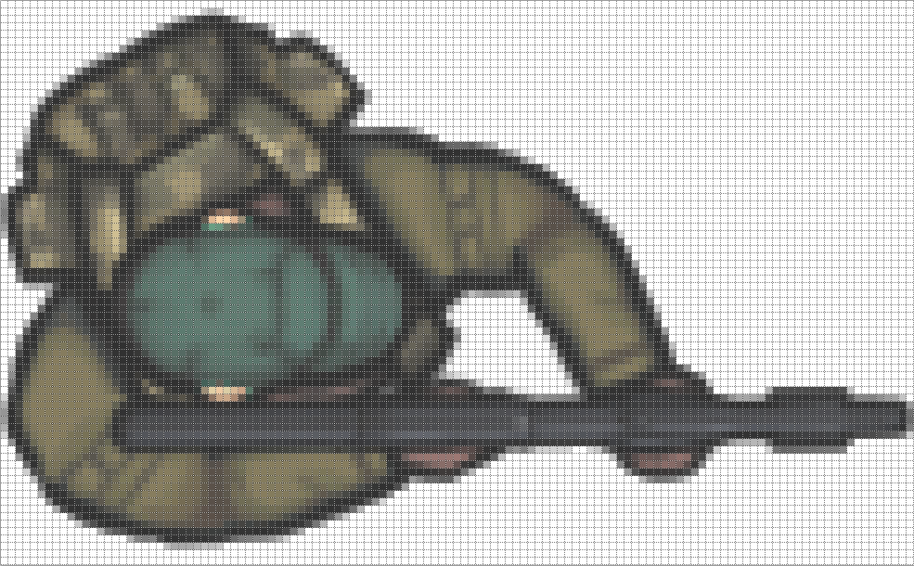
128
Center of Rotation
Center of Sprite
76
Center Offset
Gun Barrel Offset
End of
Gun Barrel

